Slide 1


Time-Series Data Analysis
SIT112 | Intro to Data Science & AI
Lecture Week 8
Dr. Fatima Ansarizadeh
Lecturer in Applied AI
School of Information Technology, Deakin University
Email: f.ansarizadeh@deakin.edu.au

Slide 2
Objectives
Generate date ranges at different time intervals.
Reindex a DataFrame with a generated date range.
Explain how reindexing time-series data can improve plots, but also how it can lead to missing values in the data.
Describe how to apply a function to fix missing values in data that’s indexed by dates.
Distinguish between downsampling and upsampling.
Explain the use of the label and closed parameters in the resample() method.
Explain how downsampling can improve plots.
Describe the use of rolling windows.

Slide 3

What is Time-Series Data?

Slide 4

Time-Series Data
Time-series data is data collected or recorded in time order, usually at regular intervals. So, unlike ordinary data, we cannot change the order of data points in a time series.
Each observation is associated with a specific time point.
Main characteristics
  1. Time order
  Observations must be arranged chronologically.
  2. Trend
  A trend is a long-term increase or decrease.
  3. Seasonality
  Seasonality is a pattern that repeats at regular intervals.
Notes:
Main characteristics
1. Time order
Observations must be arranged chronologically:
2. Trend
A trend is a long-term increase or decrease.
3. Seasonality
Seasonality is a pattern that repeats at regular intervals.
Examples:
electricity usage increases every winter;
retail sales increase every December;
4. Cycles
Cycles are increases and decreases that occur over longer periods but may not repeat at perfectly regular intervals.
Economic growth and recession are common examples.

Slide 5
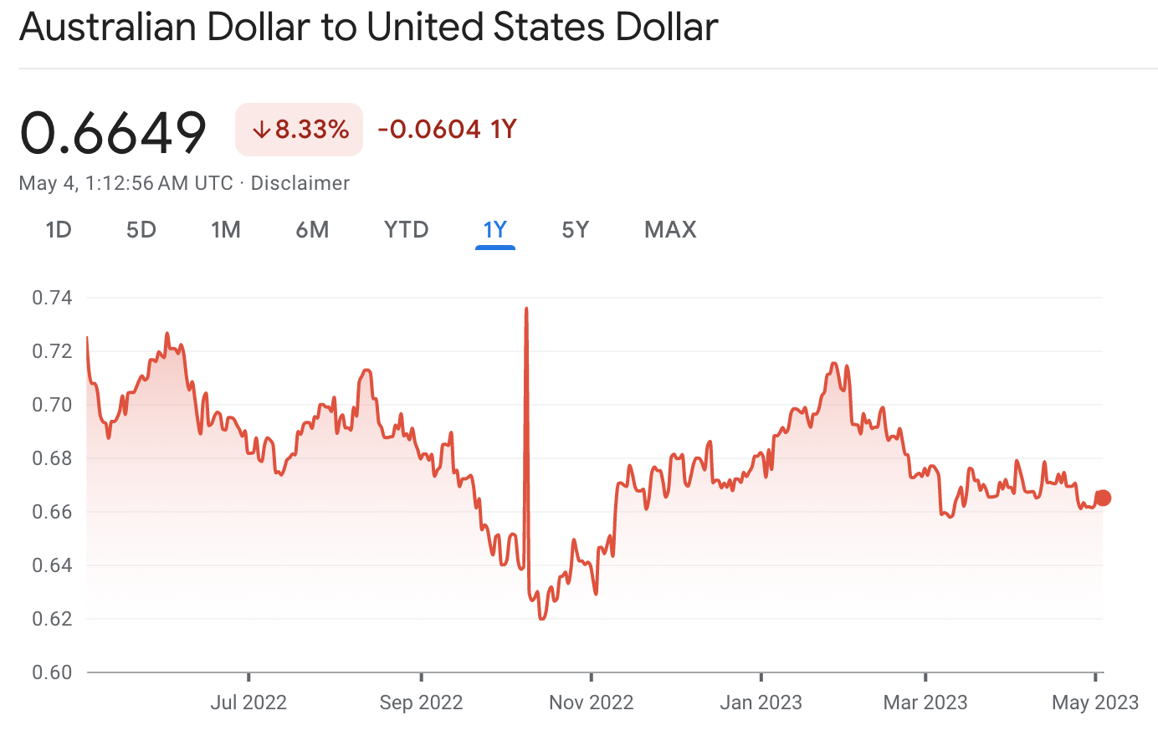
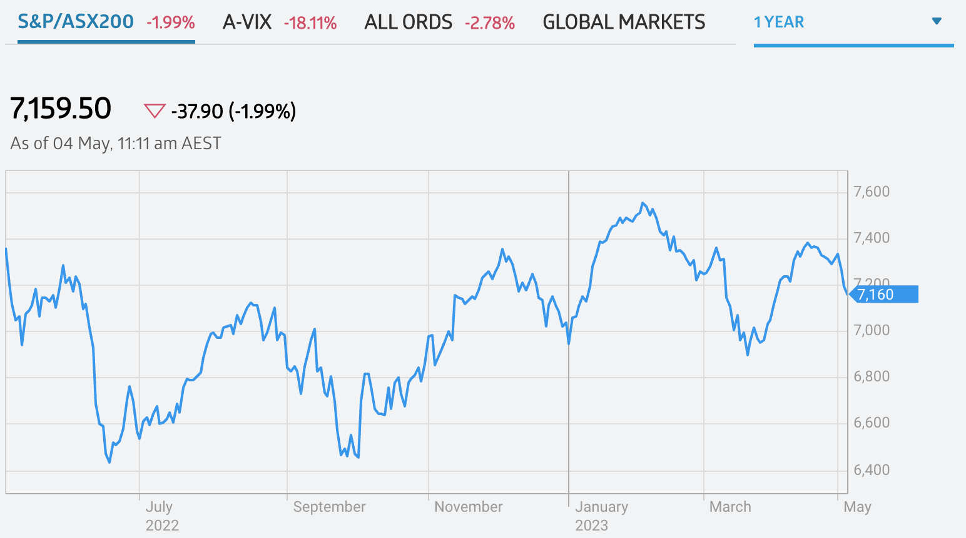
Time-Series Data; Applications in Finance
To predict market trends, estimate stock prices, and identify trading opportunities.
Notes:
Time series in finance
A financial time series is a sequence of financial values recorded in chronological order.
Examples include:
daily share prices;
hourly cryptocurrency prices;
monthly company revenue;
quarterly profit;

Slide 6
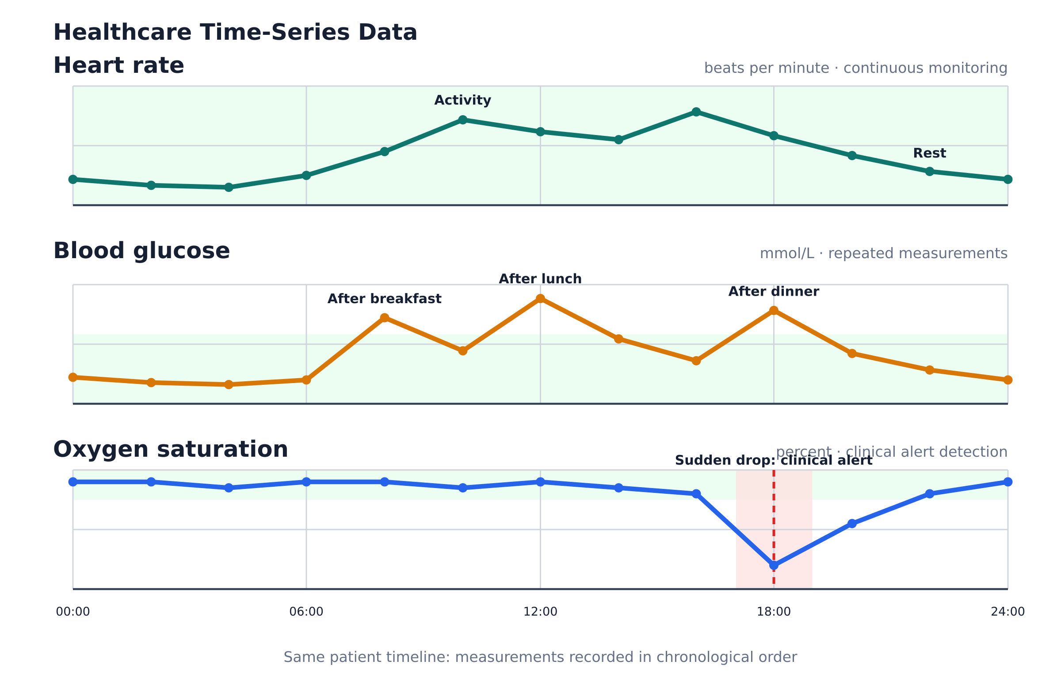
Time-Series Data; Applications in Healthcare
It is a sequence of health-related measurements recorded for a patient, hospital, or population over time.
Healthcare time-series data includes:
Heart rate: changes with activity, rest and sleep.
Blood glucose: rises after meals and then gradually falls.
Oxygen saturation: a sudden drop may trigger a clinical alert.
Notes:
A healthcare time series is a sequence of health-related measurements recorded for a patient, hospital, or population over time.
The order and timing of observations are important because healthcare professionals want to understand how a condition changes.
xamples
Healthcare time-series data includes:
heart rate recorded every second;
blood pressure measured daily;
blood glucose measured throughout the day;

Slide 7
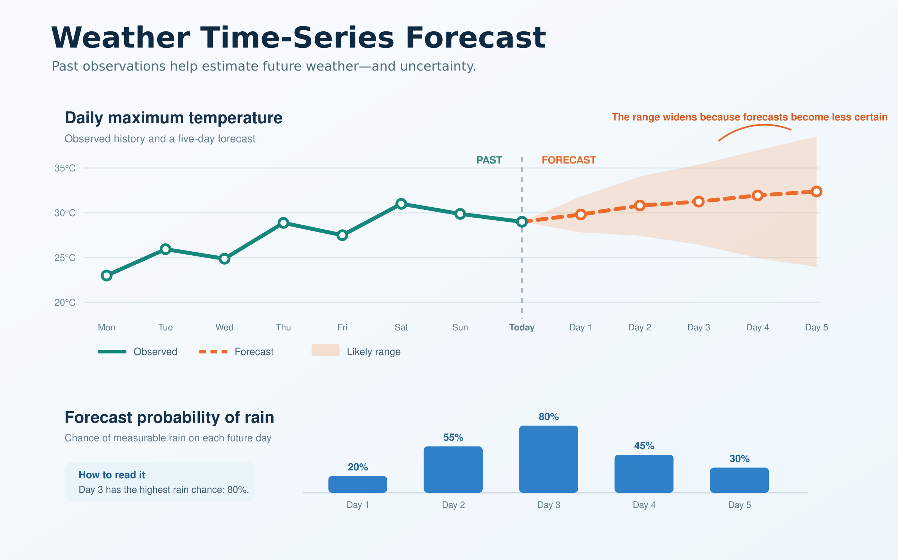
Time-Series Data Applications; Weather Forecasting
Weather forecasting uses measurements collected over time, such as temperature, rainfall, humidity, wind speed and direction, atmospheric pressure, and cloud cover.
Weather time-series models may learn:
trends: gradual warming or cooling;
daily cycles: warmer during the day and cooler at night;
seasonality: recurring summer and winter patterns;

Slide 8

Movie Time ☺

Slide 9
Generate time series

Slide 10
The date_range( ) Method
Method | Description
date_range(params) | Generates a list of datetime periods and returns a DatetimeIndex that contains them.
Alias | Frequency | Alias | Frequency
B | business day | Q | quarter end
D | calendar day | QS | quarter start
W | weekly | Y | year end
M | month end | YS | year start
SM | semi-month end (15th and last day) | h | hourly
MS | month start | T | minutely
SMS | semi-month start (1st and 15th) | S | secondly
Parameter | Description
start | The start of the generated datetime values.
end | The end of the generated datetime values.
freq | The frequency of the generated datetime values.
Notes:
pd.date_range() creates a sequence of dates or timestamps at regular intervals. It is especially useful for constructing a time-series index.
The default frequency is one day.
Freq: Distance between timestamps

Slide 11
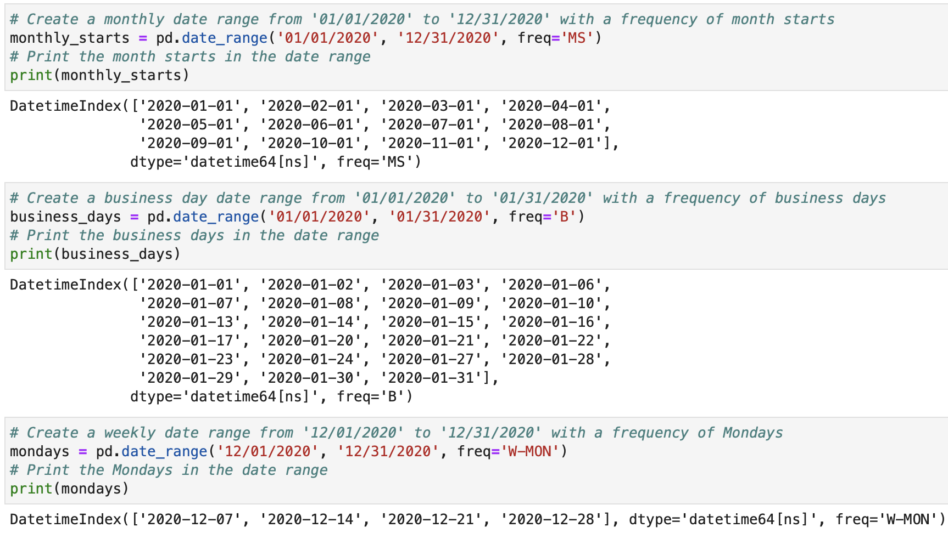
Generating Time Periods

Slide 12
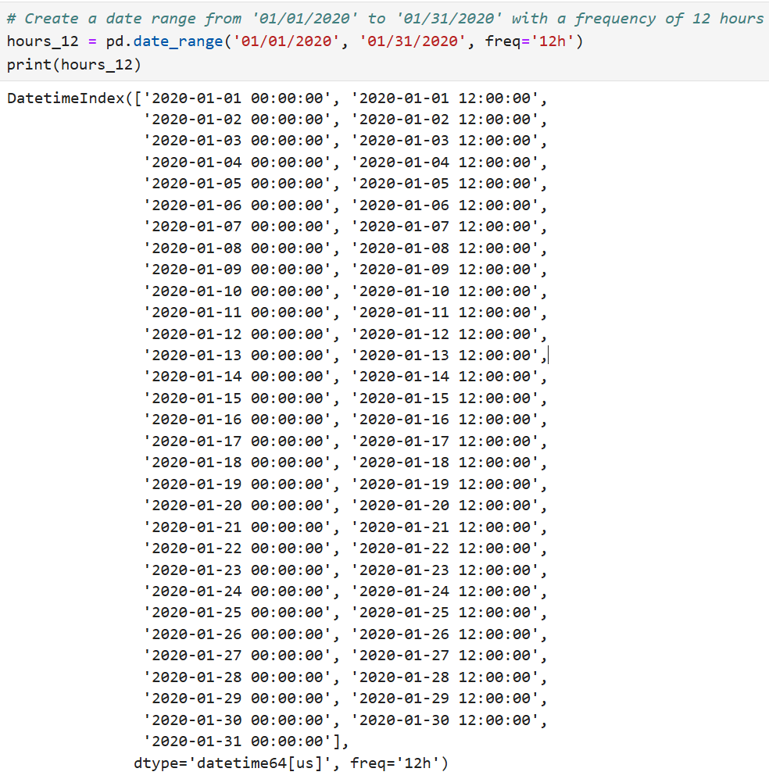
Generating Time Periods (Cont.)

Slide 13
How to Reindex Time-Series Data

Slide 14
What is reindexing?
Reindexing is a powerful technique for manipulating and transforming time-series data.
It means changing the DataFrame’s time index to a new set of dates or times.
It is commonly used to:
  Add missing dates or times
  Make observations occur at regular intervals
  Change the date range
  Arrange dates in chronological order

Slide 15
Why Reindexing?
Applications of reindexing time-series data include:
  Resampling: Reindexing time-series data allows you to resample data at different frequencies, such as converting daily data to weekly or monthly data, or aggregating data to a lower frequency to reduce noise in the data.
  Aligning: Reindexing time-series data can help align multiple time-series datasets that have different frequencies or time indices. This is useful for comparing and analysing datasets that are not synchronised.
  Shifting: Reindexing time-series data can help shift the time index by a certain offset, which is useful for aligning data from different sources or for analysing time shifts in the data.

Slide 16
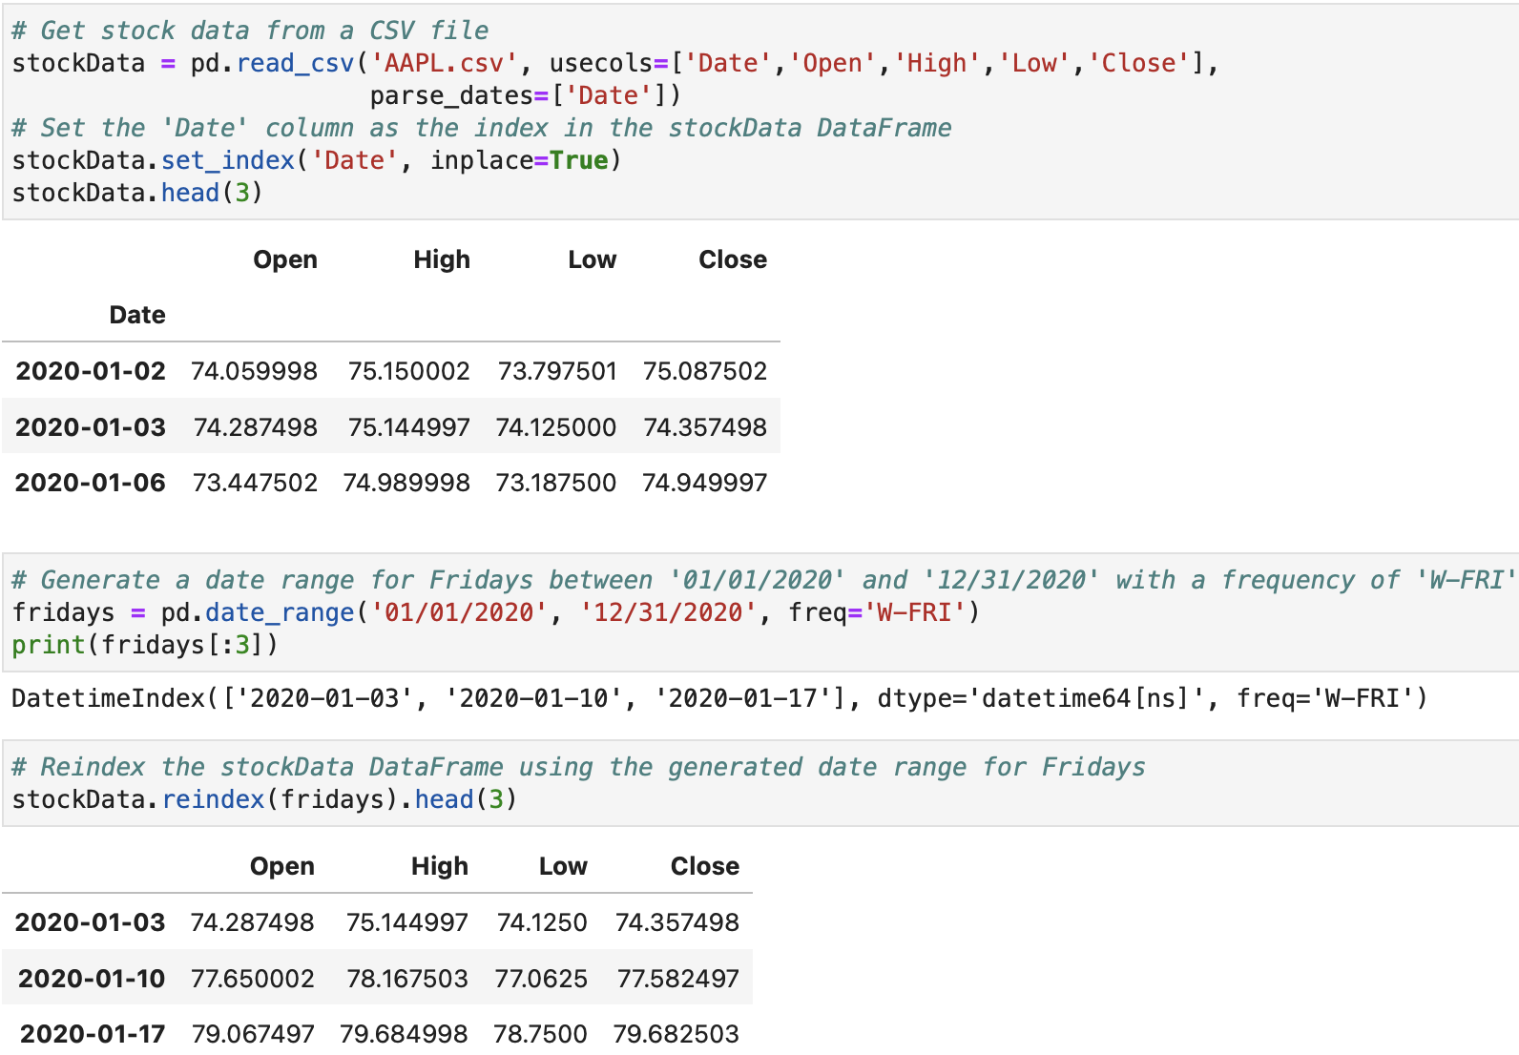
Reindexing with Datetime Indexes
Notes:
parse_dates tells pd.read_csv() to convert selected columns into pandas datetime values while loading a CSV file.
Without parse_dates, the date column may be read as text.
Pandas compares new_dates with the existing index:
Existing matching dates → their data is retained.
New dates not previously present → new rows containing NaN.
Old dates not included in new_dates → those rows are removed.
Rows are reordered according to new_dates.
This is different from directly replacing the index:
df.reindex(new_dates) does not simply replace the existing index values.
It makes the DataFrame conform to the new index and matches rows using index labels.

Slide 17
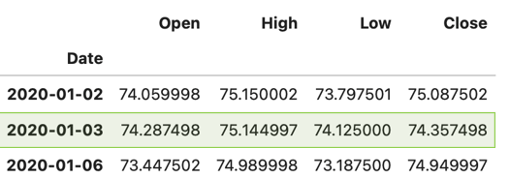
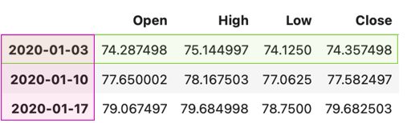
What is df. reindex ( ) doing?
Pandas compares new_dates with the existing index:
  Existing matching dates → their data is retained.
  New dates not previously present → new rows containing NaN.
  Old dates not included in new_dates → those rows are removed.
  Rows are reordered according to new_dates.
This is different from directly replacing the index.

Slide 18

Reindexing with Datetime Indexes;
Missing Values
In the previous example, when the data is reindexed, only the rows for Fridays remain in the DataFrame.
There will be some missing values in the reindexed data because the stock market isn’t open on holidays, and some of them fall on Fridays in 2020, including Good Friday, Independence Day, and Christmas.

Slide 19
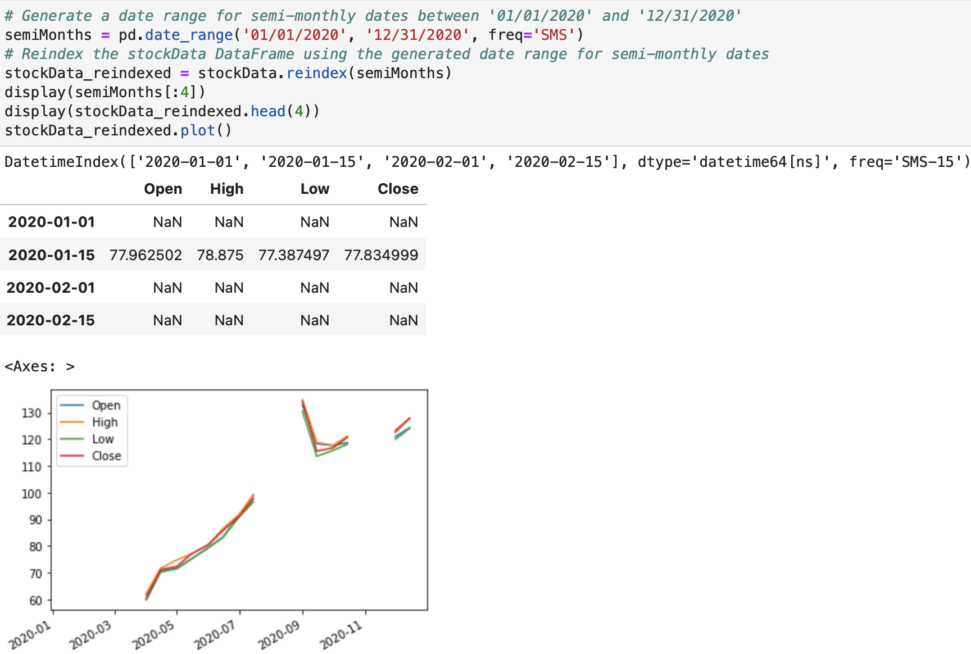
Reindex with a Semi-Month Index
The datetime index for the x-axis
The numerical columns for the y-axis
A separate line for each numerical column

Slide 20
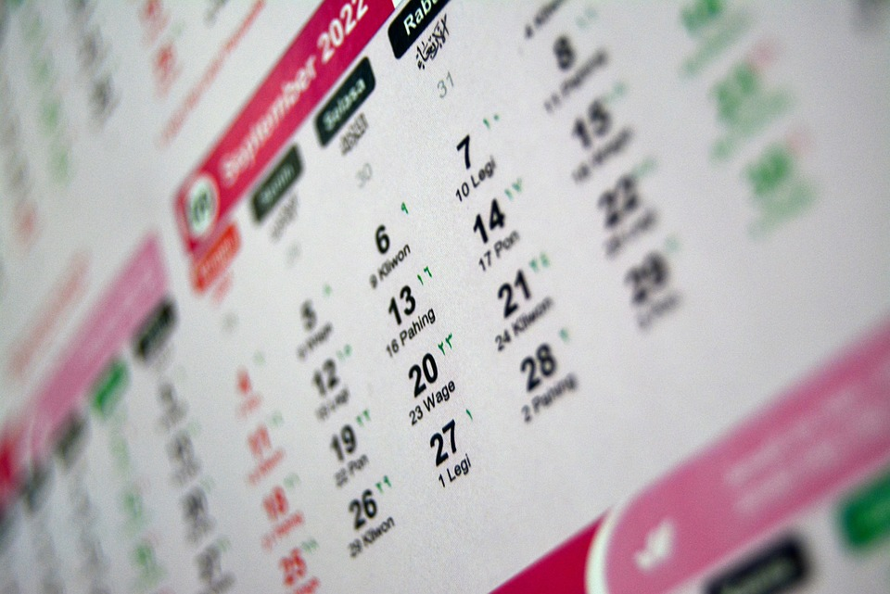
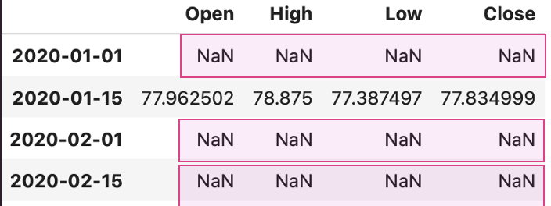
Reindex with a Semi-Month Index; Missing Values
In the previous example, of the two dates, the first one is always the 1st of the month and the second one is always the 15th .
Because of this, the dates often land on the weekends, and that creates missing values.
Notes:
This refers to using a semi-monthly date range, which selects two dates each month:
The 1st day of the month
The 15th day of the month
For example:
1 January
15 January
1 February
15 February
1 March
15 March
However, the original stock-market dataset normally contains data only for business days. The stock market is closed on Saturdays, Sundays and some public holidays.
For example, suppose the generated dates include:
2020-02-01 → Saturday
2020-02-15 → Saturday
When the DataFrame is reindexed using these dates, Pandas cannot find matching rows in the original stock data. It therefore creates the rows and assigns NaN.

Slide 21
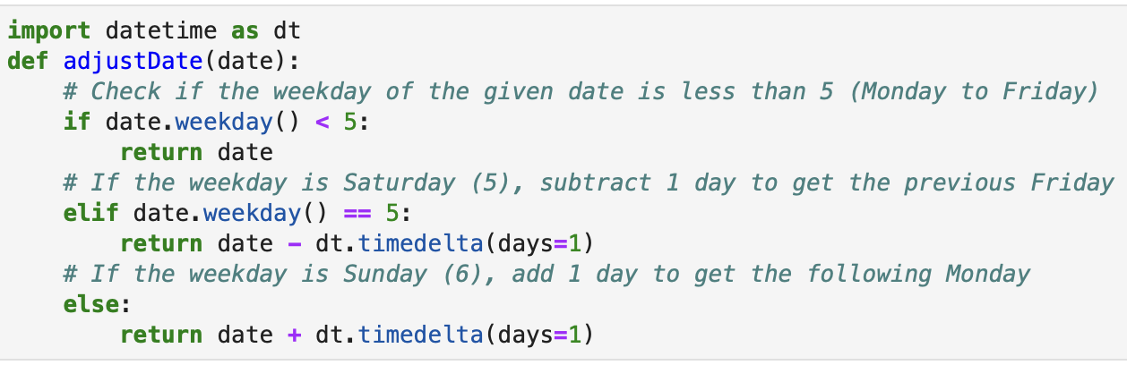
Reindex with a Semi-Month Index;
Fixing Missing Values
Notes:
date.weekday()
.weekday() returns the day of the week as an integer for a Python date or datetime value.
Number Day
0 Monday
1 Tuesday
2 Wednesday
3 Thursday
4 Friday
5 Saturday
6 Sunday

Slide 22
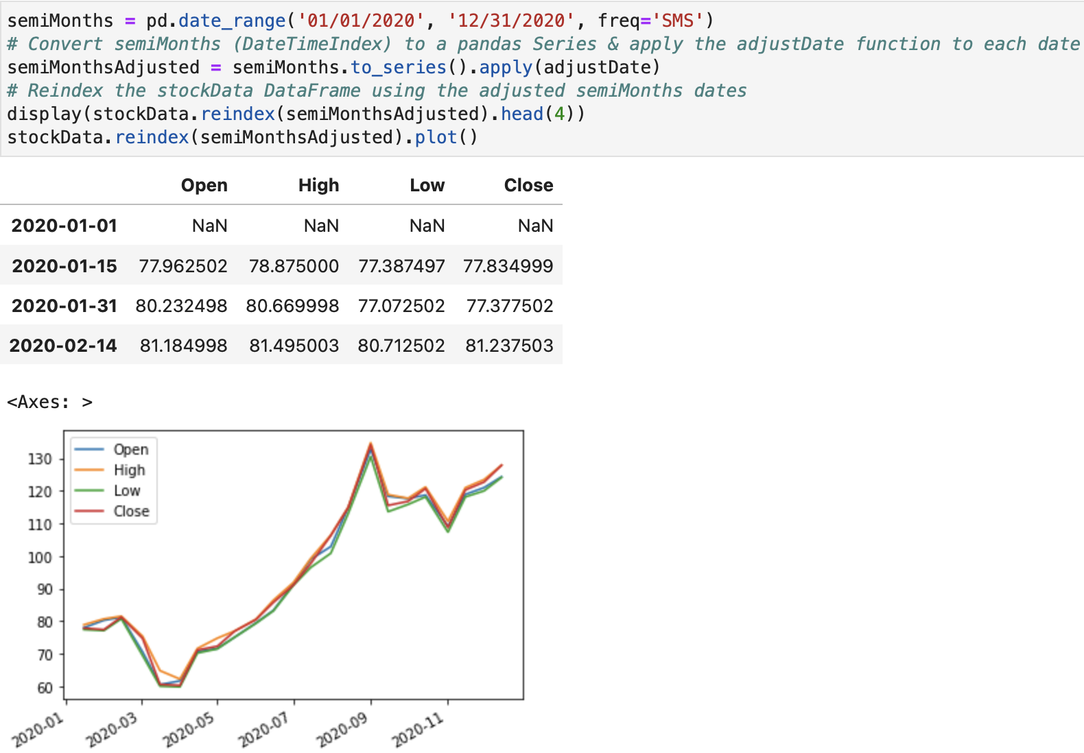
Reindex with a Semi-Month Index; Fixing Missing Values

Slide 23
How to Resample Time-Series Data

Slide 24

What is Resampling?
Changing the frequency of the time series data.
Useful for adjusting the data to match the frequency of another dataset, reducing noise, preparing the data for forecasting, and improving computational and storage efficiency.
Two main types of resampling:
  Downsampling
  Upsampling
Notes:
Resampling means changing the time frequency of data—for example:
Daily data → monthly data
Hourly data → daily data
Monthly data → daily data
It is similar to groupby(), but the groups are created from time intervals.

Slide 25
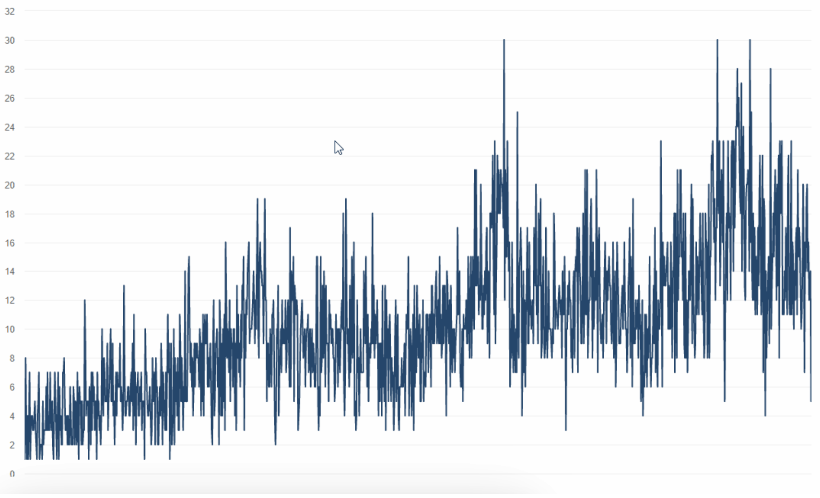
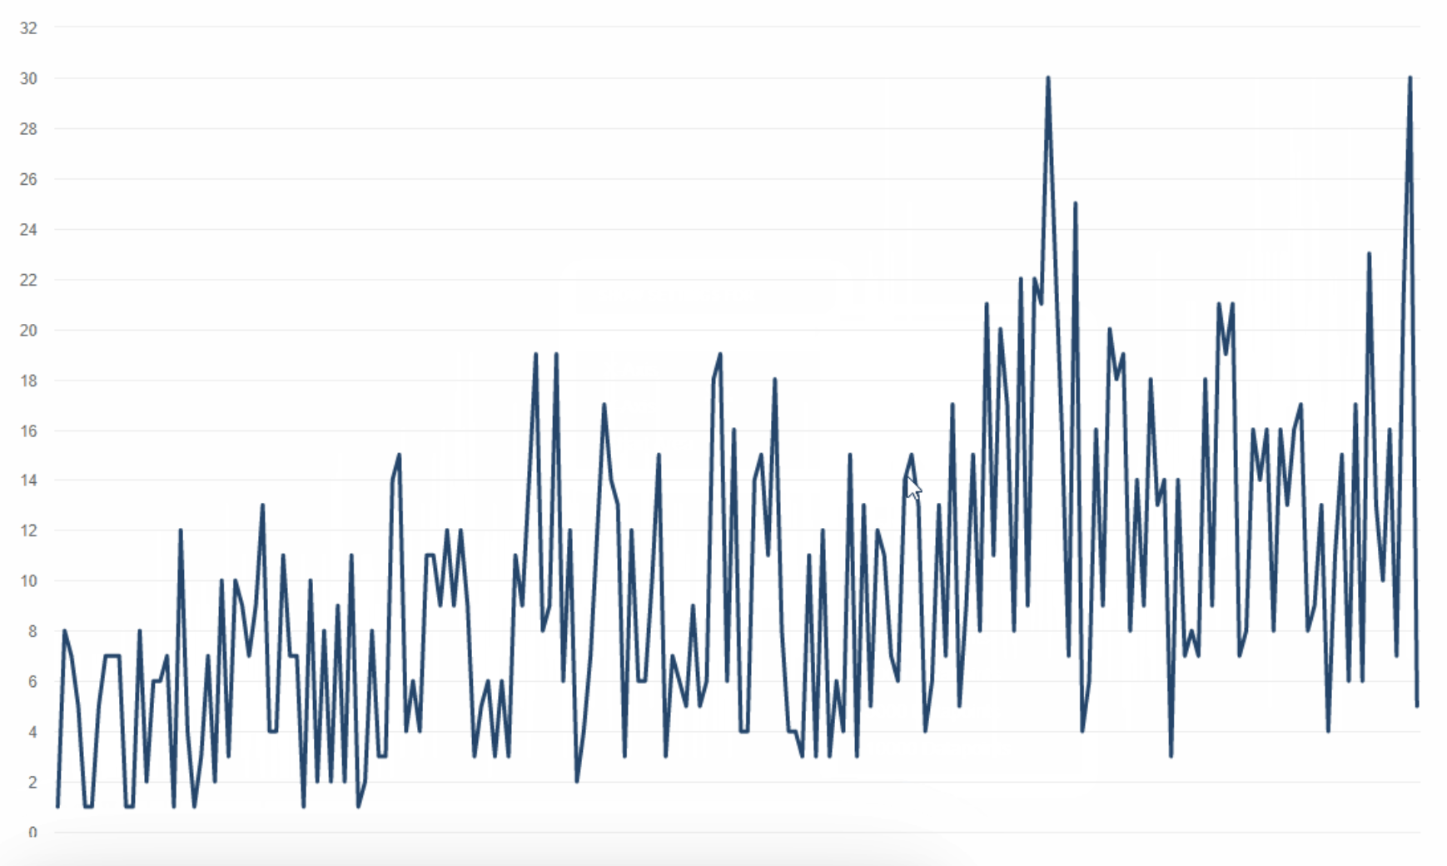
Downsampling
Reducing the frequency of the data by aggregating or summarising it over larger time intervals.
When you have high-frequency data, but you only need to analyse it at a lower frequency.
When you need to reduce the size of the data for storage or computational efficiency.
Notes:
E.g., minute-level stock price data for a whole year can be downsampled to daily summaries.

Slide 26
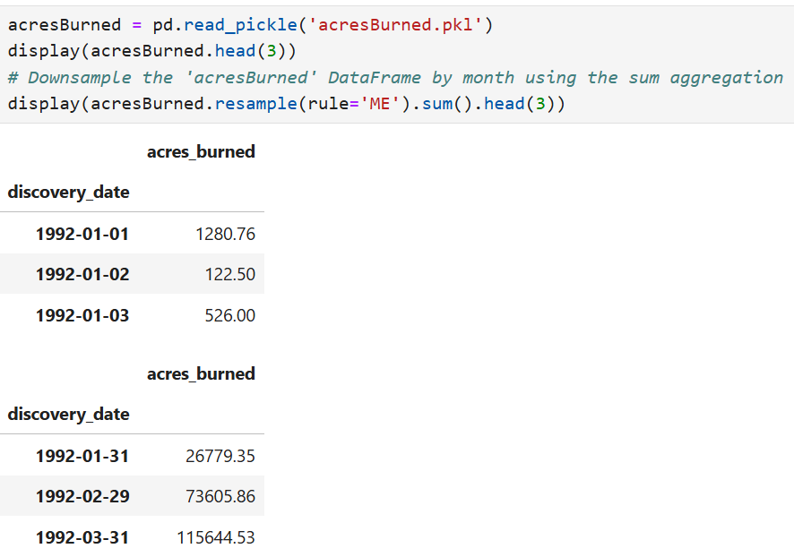

Downsampling; using resample()
Downsample
Notes:
Pd.date_range() creates timeline
.reindex() makes the DF follow this timeline.

Slide 27
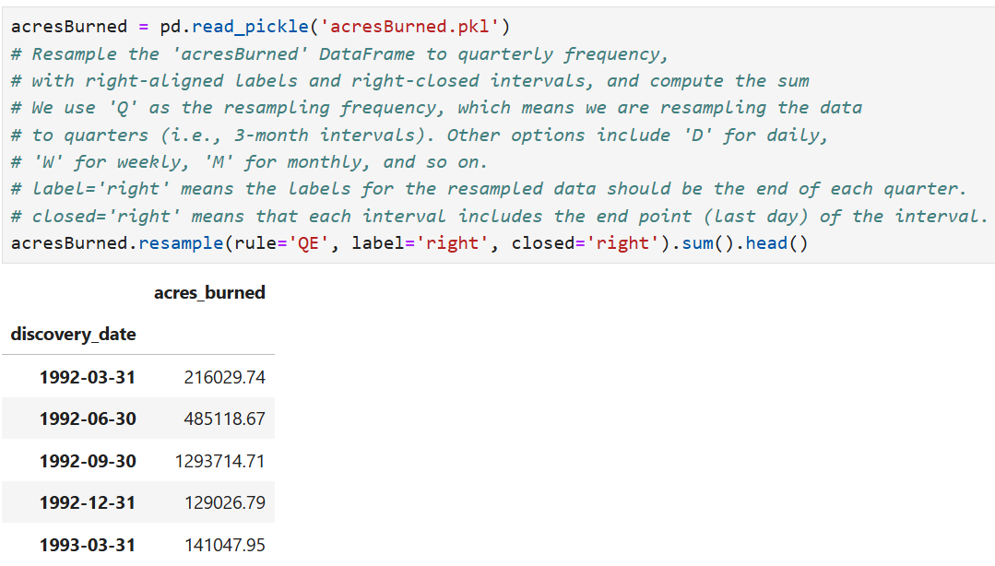
Downsampling; the label & closed Parameters

Slide 28
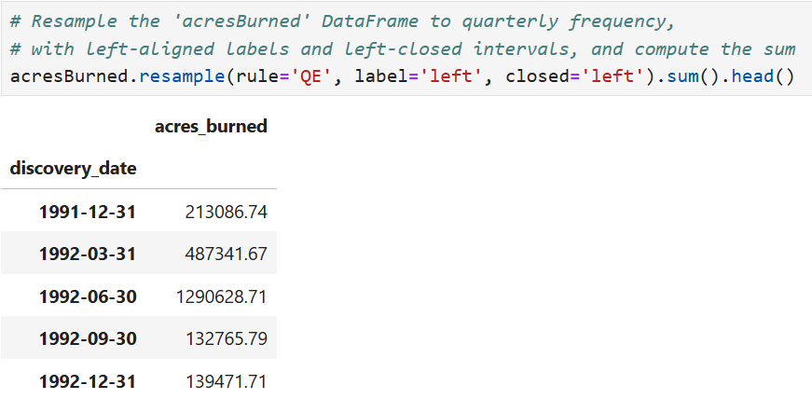
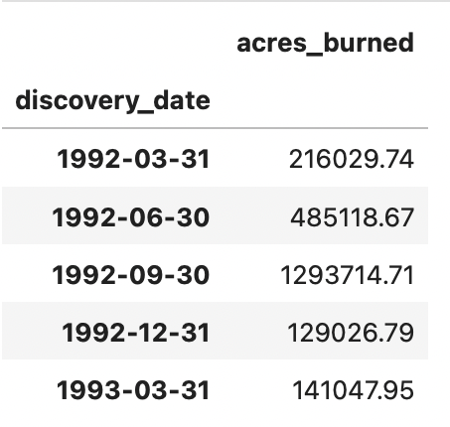
Downsampling; the label & closed Parameters (Cont.)
What causes the small differences in the values in these two tables?

Slide 29


Resample with label = ‘left’ & closed = ‘right’
What happens if you execute the following line?

Slide 30
Downsampling; Improving Plots
When plotting time series data with a large number of data points, it can become difficult to see the overall trend of the data due to excessive noise or variability in the data.
Downsampling can help by reducing the number of data points displayed on the plot, thereby reducing the noise and making it easier to see the underlying trend of the data.
Particularly helpful when visualising long-term trends or when presenting the data.
E.g., if the original time series data includes daily stock prices, downsampling to weekly or monthly data points can help to smooth out the plot and make it easier to identify trends.

Slide 31
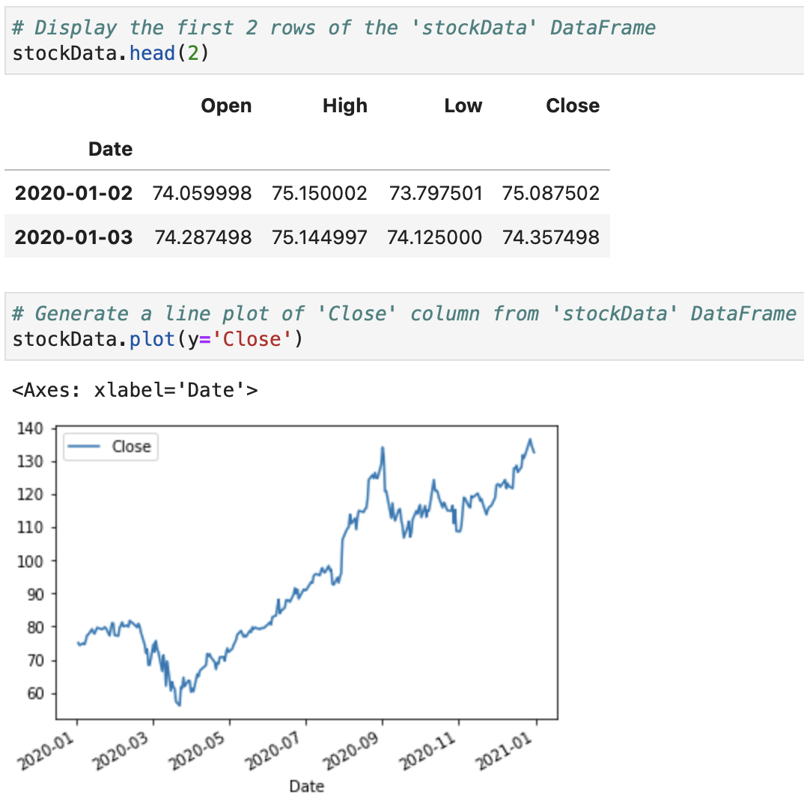
Downsampling; Improving Plots (Cont.)

Slide 32
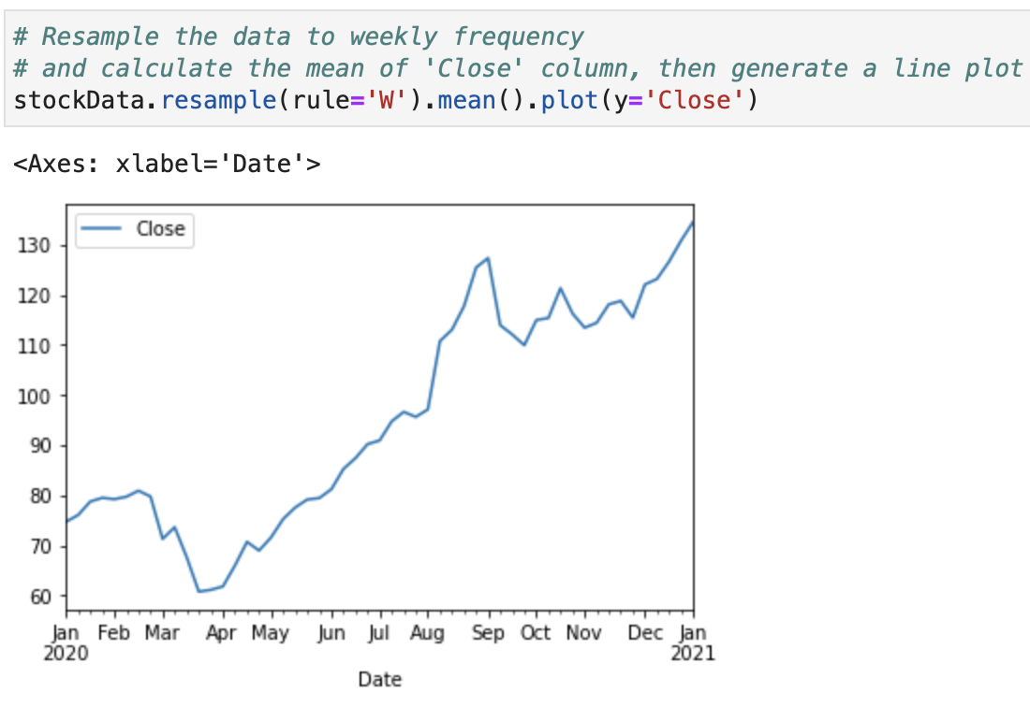
Downsampling; Improving Plots (Cont.)

Slide 33




Upsampling
Involves increasing the frequency of the time series data.
E.g., converting daily data to hourly data.
Can be done using various techniques such as interpolation and filling missing values.

Slide 34
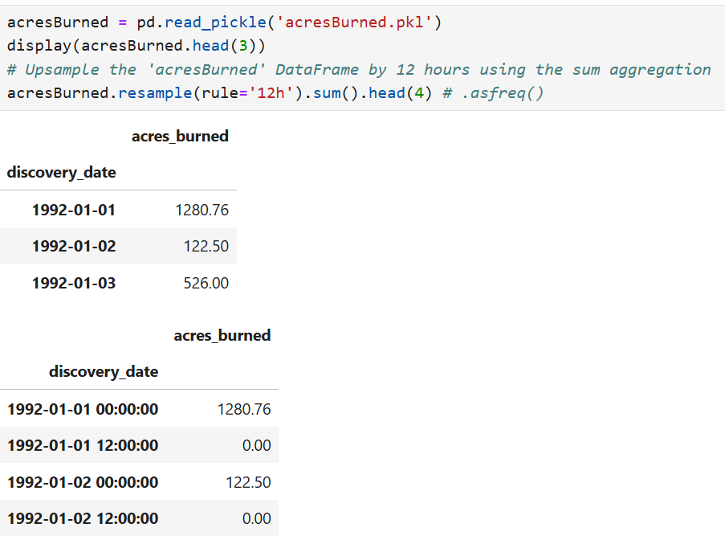
Upsampling; using resample()
Notes:
Upsampling changes less-frequent observations into a more-frequent timeline.
For example, monthly data can become daily data:
New dates normally contain NaN because the original data does not provide values for them.
You can fill them in different ways:
# Use the previous known value
df.resample('D').ffill()
# Use the next known value
df.resample('D').bfill()
# Estimate values between observations
df.resample('D').interpolate()

Slide 35
Upsampling;
Missing Values
When you upsample a time-series dataset, new rows are inserted into the DataFrame for the missing time periods. Since the original dataset has a lower frequency than the resampled data, some of the new rows will have missing data, which will be filled with NaN values.
In this case, the sum aggregation method is used to calculate the sum of the acresBurned values for every 12 hours. When the sum function encounters a NaN value, it treats it as zero, which can lead to some zero values in the resampled DataFrame.

Slide 36
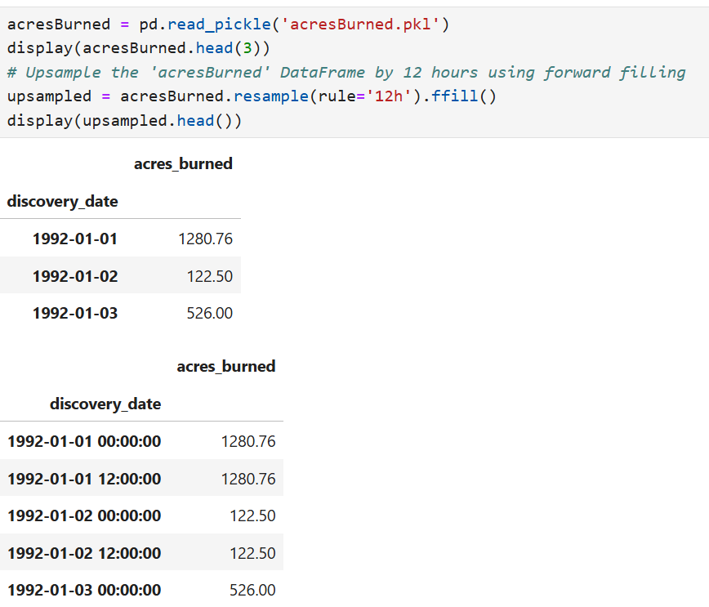
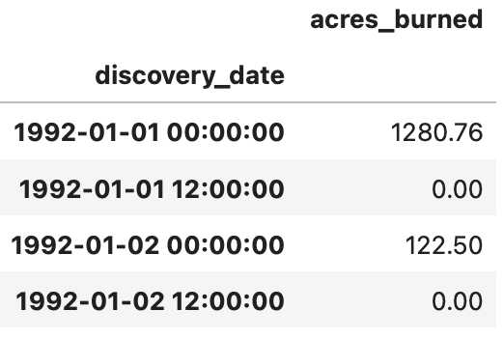
Upsampling;
Fixing Missing Values
Notes:
Downsampling: aggregate
Downsampling means changing from a higher frequency to a lower frequency, so multiple observations fall into each new time period. We therefore need an aggregation function to combine them.
Upsampling: fill or estimate
Upsampling means changing from a lower frequency to a higher frequency. This creates new timestamps without recorded values, so they initially contain NaN.
You can then handle the missing timestamps with:
df.resample('D').ffill() # Use the previous value
df.resample('D').bfill() # Use the next value
df.resample('D').interpolate() # Estimate values between observations

Slide 37
Rolling Windows

Slide 38
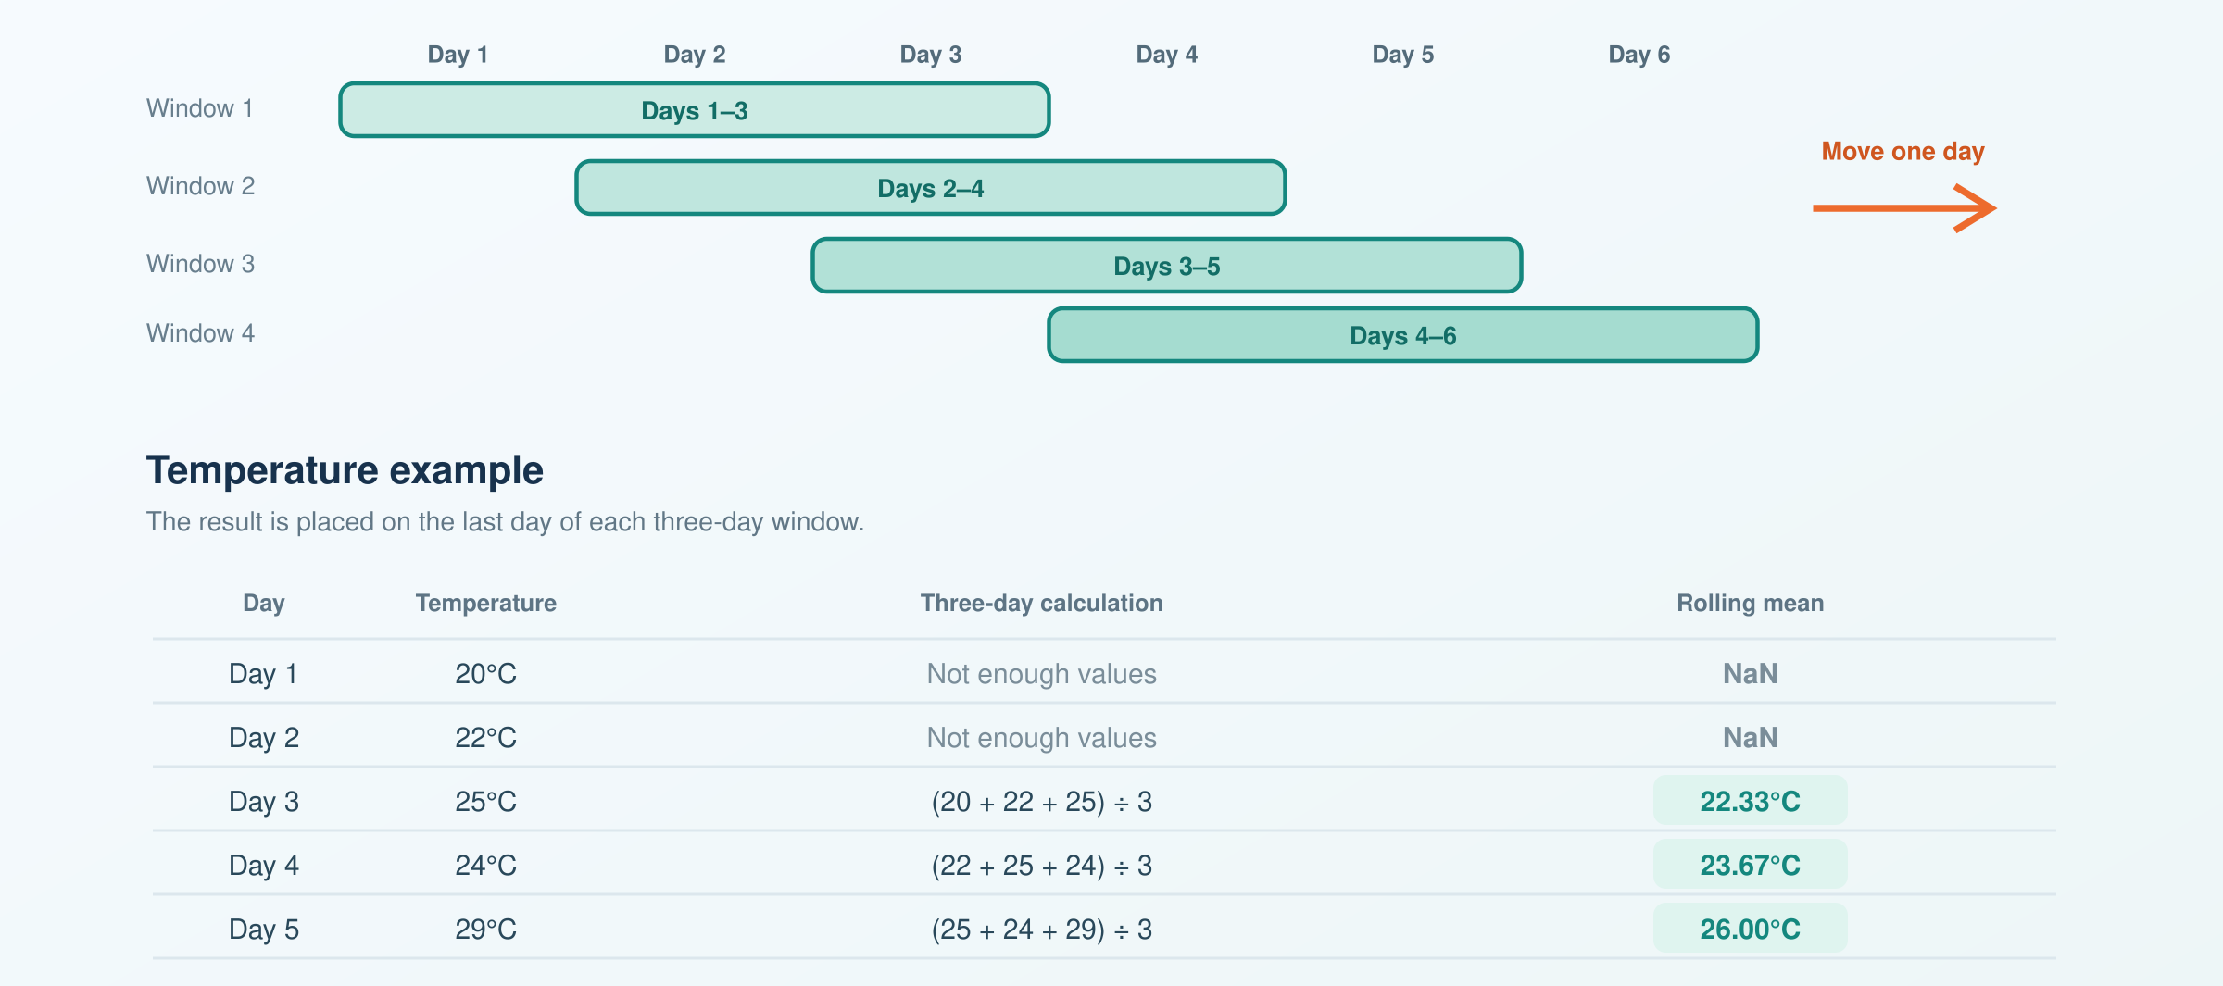
The Concept of Rolling Windows
A rolling window selects a fixed number of consecutive observations, performs a calculation, and then moves forward one observation at a time.
For example, a three-day rolling mean calculates the average of:
  Days 1–3
  Days 2–4
  Days 3–5
  Days 4–6
Notes:
To compute aggregate statistics over a moving window of time.
Involves sliding a window of fixed size over the time-series data and applying a function to the data within each window.
Useful for smoothing noisy data and detecting anomalies.
E.g., a rolling window can be used to compute a moving average of a time-series dataset.
The moving average at each time point is computed by taking the average of the data within a fixed window size, which slides along the time axis.

Slide 39
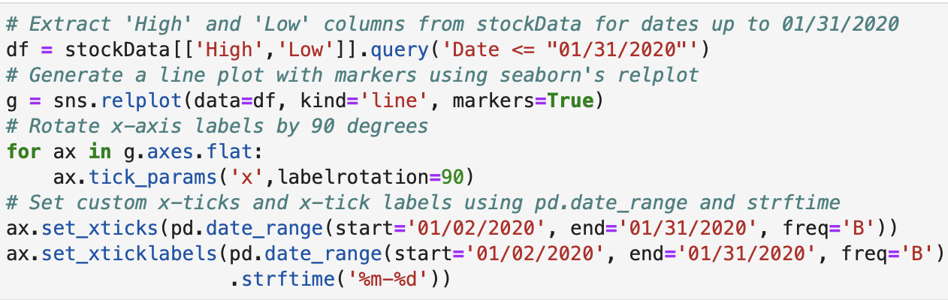
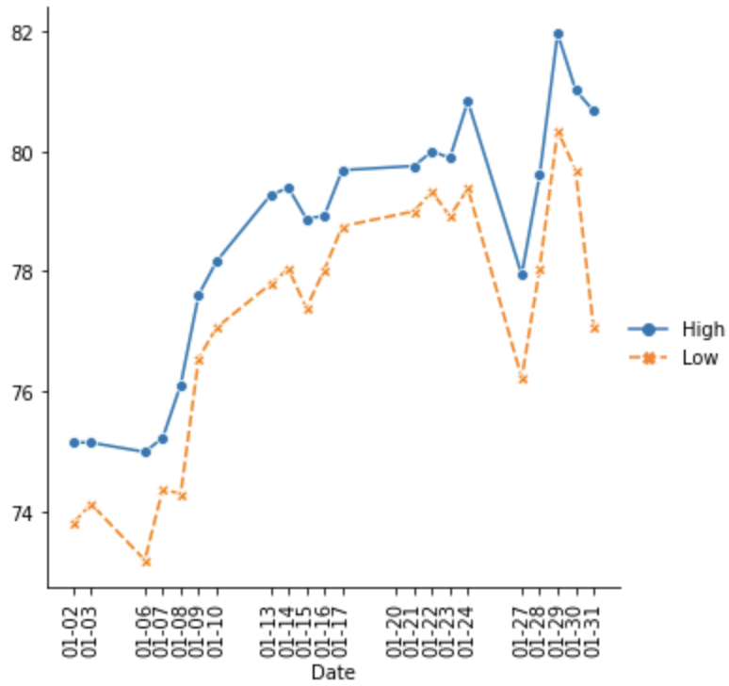
Rolling Windows

Slide 40
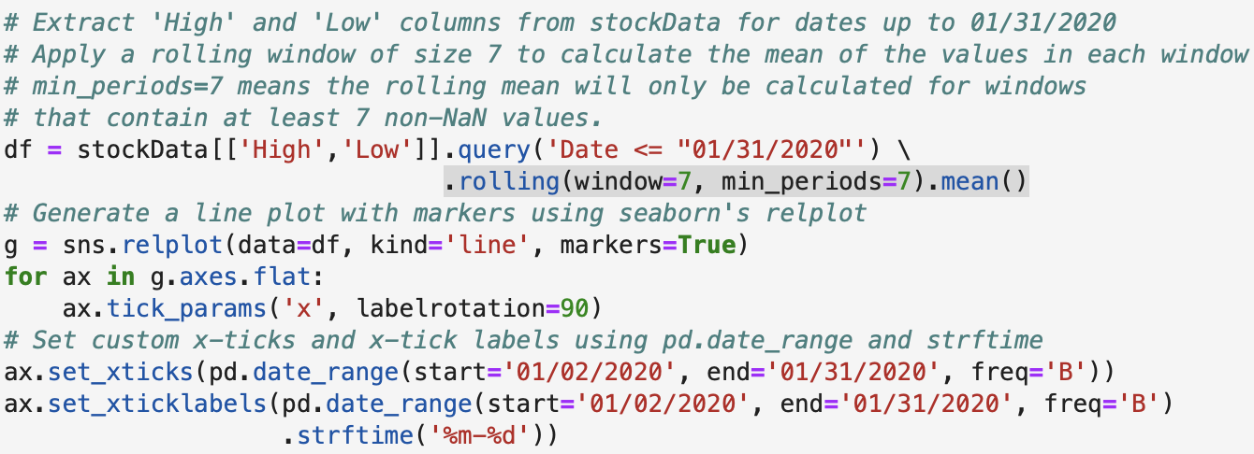
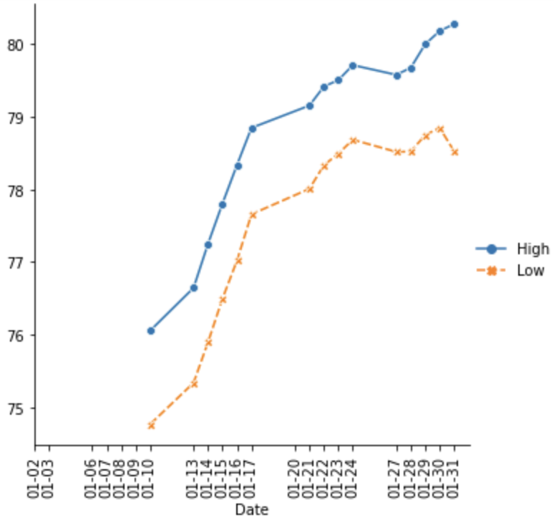
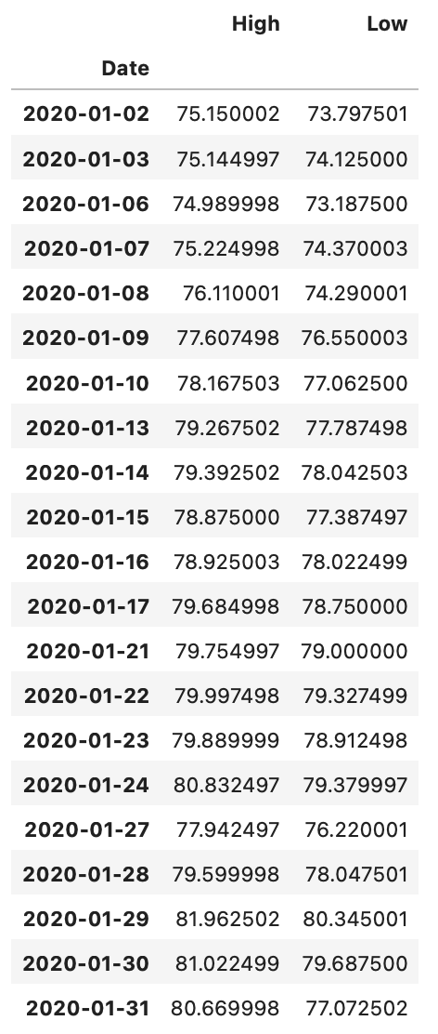
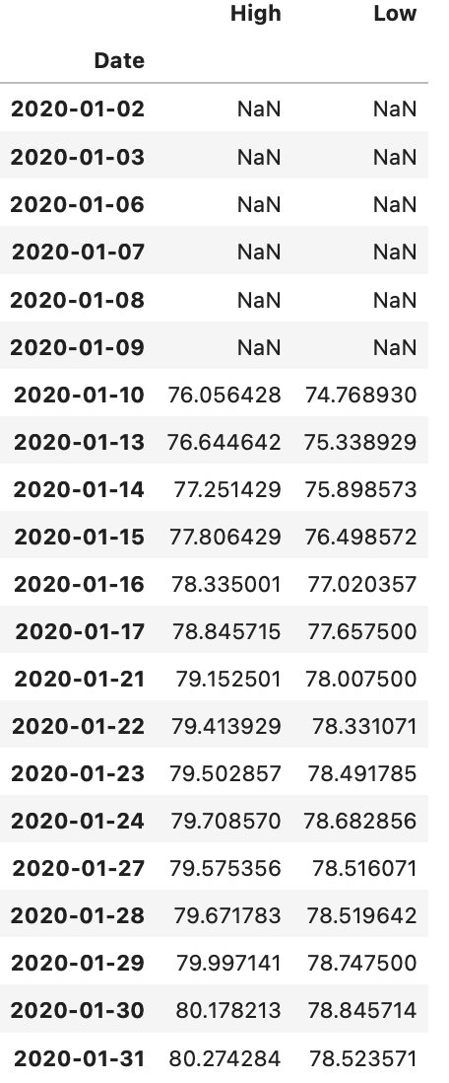
Rolling Windows (Cont.)

Slide 41
Expanding & Running Totals

Slide 42
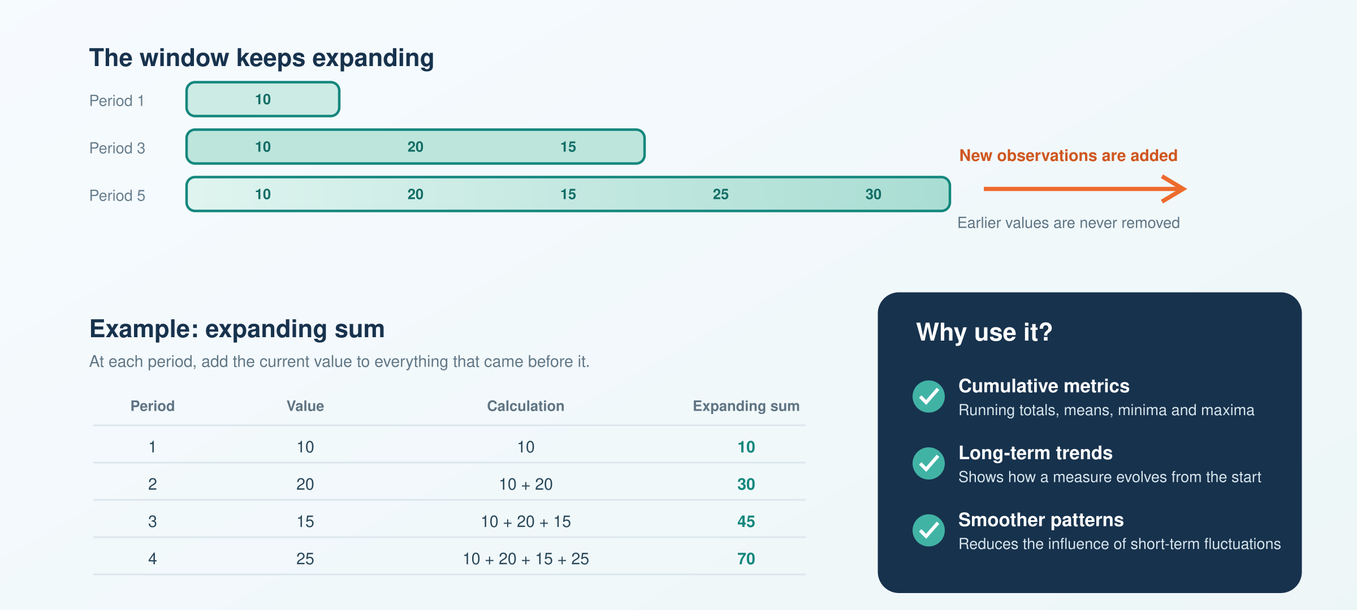
The Concept of Expanding
An expanding window starts with the first observation and includes more data as it moves forward.
Unlike a rolling window, old observations are never removed.
Notes:
A method for calculating a cumulative metric in time series data.
Unlike a rolling window, which calculates the metric over a fixed time window, the expanding method calculates the metric over all the preceding time periods.
Start with the value of the metric at the first time period, then calculate the cumulative value of the metric for all the preceding time periods.
E.g., the expanding sum of a time series would be the sum of all values up to and including the current time period.
The expanding method is useful for analyzing long-term trends in time series data, and for identifying patterns that may not be visible in shorter time windows. It can also help to smooth out short-term fluctuations and highlight longer-term trends in the data.

Slide 43
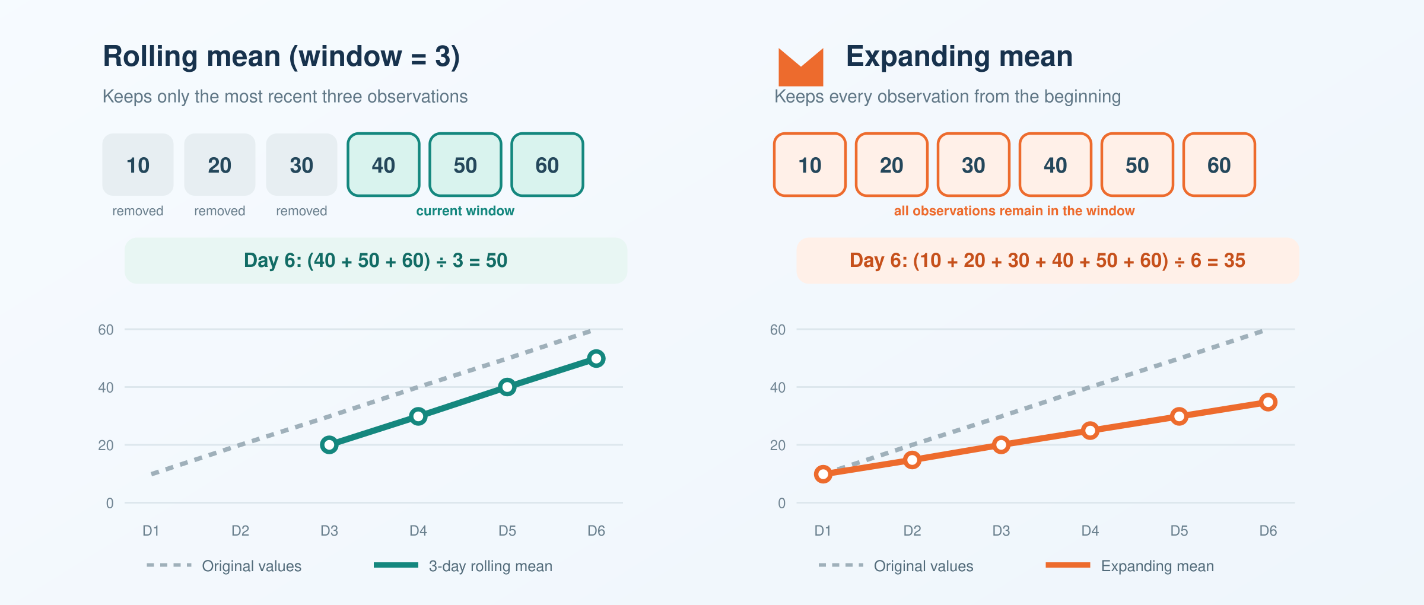
Compare rolling and expanding windows
Notes:
Use a rolling window when recent behaviour matters, such as:
A seven-day temperature average
A 30-day stock-price average
Recent website traffic
Short-term volatility
Use an expanding window when the full history matters, such as:
Average sales since the beginning of the year
Total rainfall recorded so far
Cumulative profit
Overall performance since a project started
The central difference is:
Rolling uses a fixed amount of recent history; expanding uses all available history from the beginning.

Slide 44
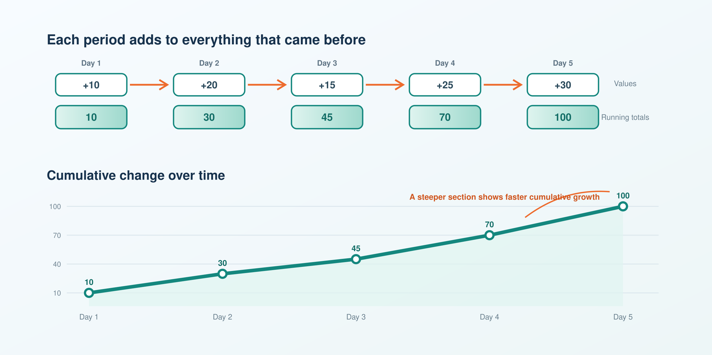
Running Totals
A running total is an expanding calculation that adds each new value to all previous values. It helps track cumulative trends and identify unusual changes over time.
Notes:
Running totals are a type of expanding calculation that involve adding up the values of a time series over time, starting from the first time period and including all the previous values up to the current time period.
Running totals are often used to track cumulative changes or trends in the data, or to identify key inflection points or anomalies in the time series.

Slide 45
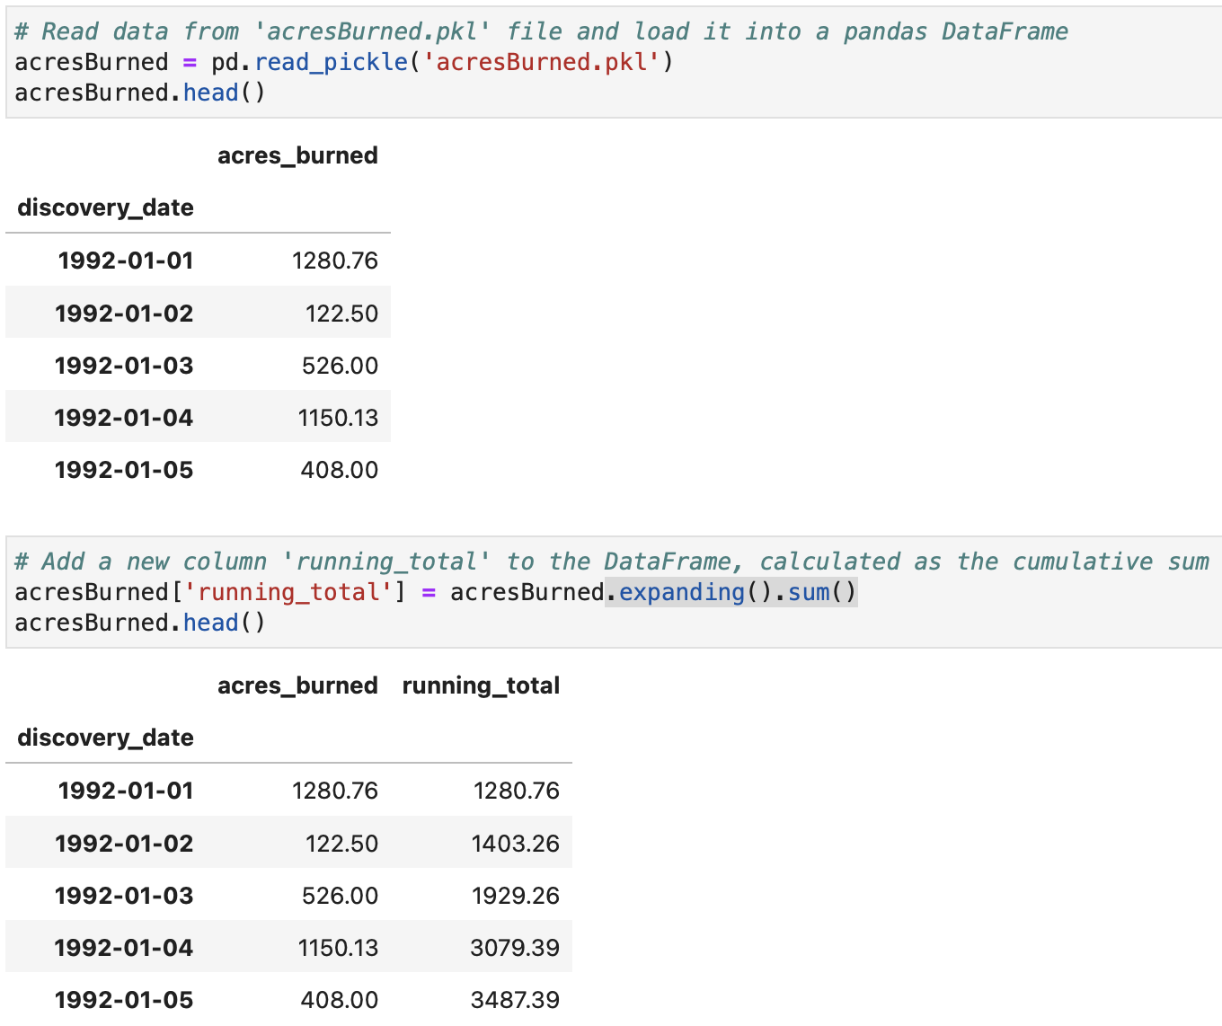
Running Totals using expanding()

Slide 46
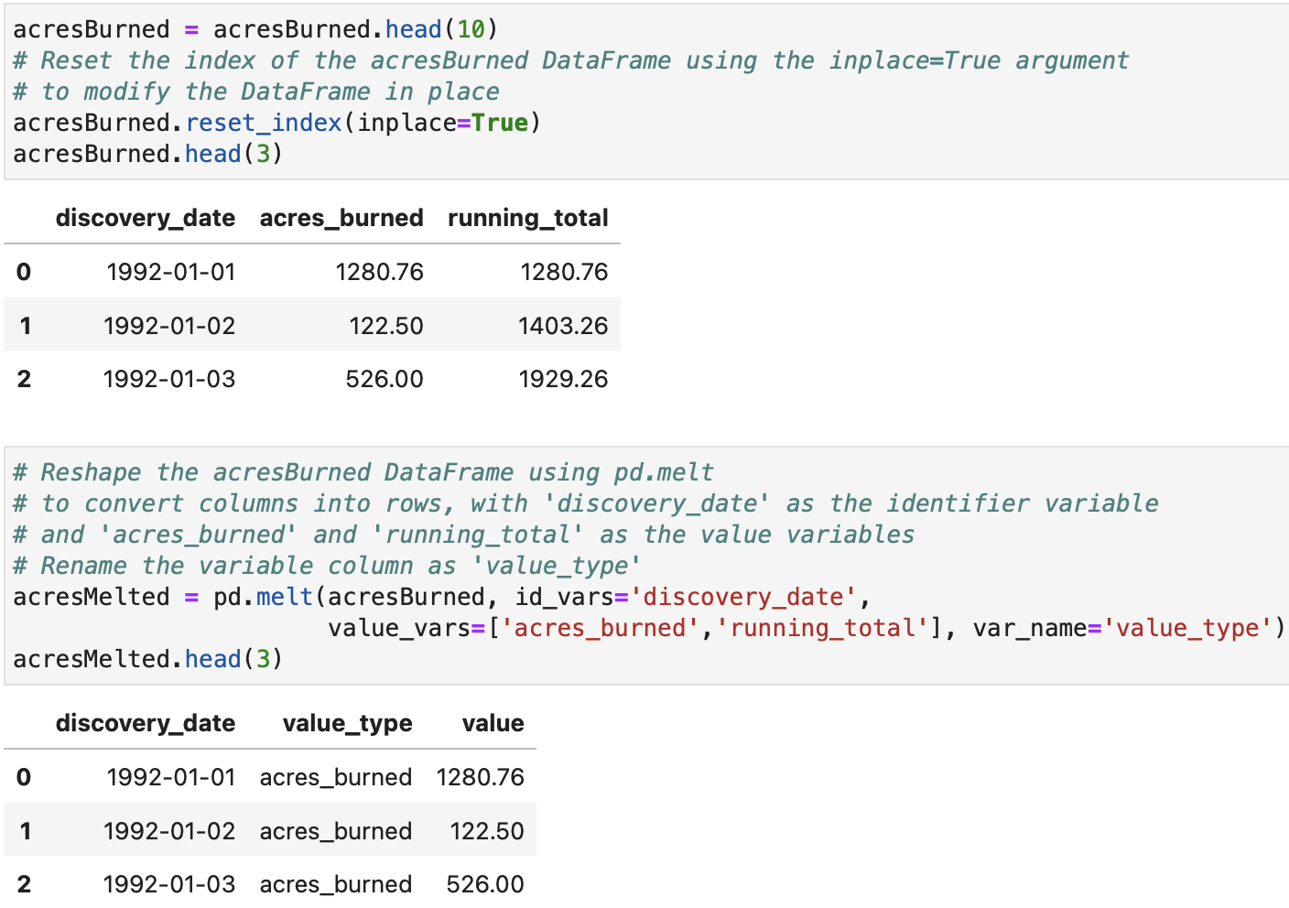
How to Plot Running Totals

Slide 47
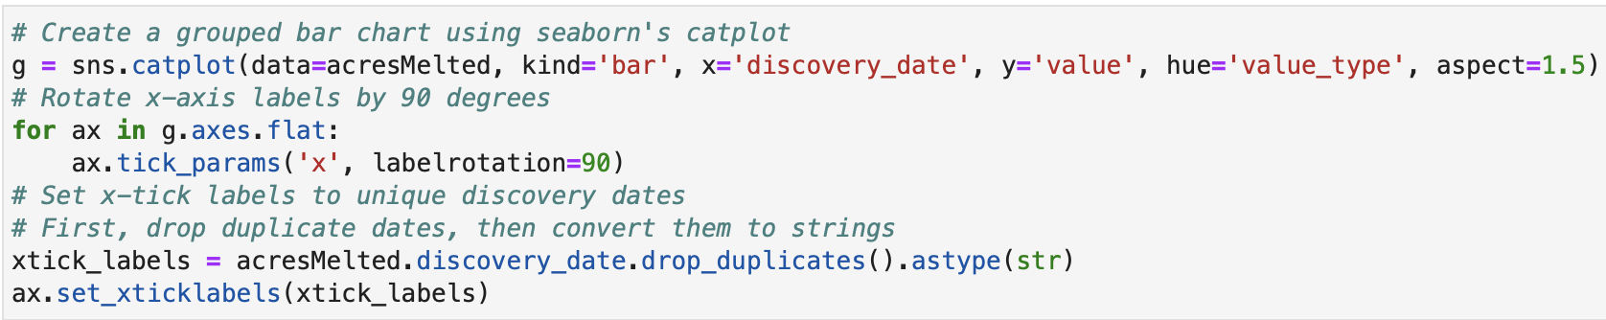
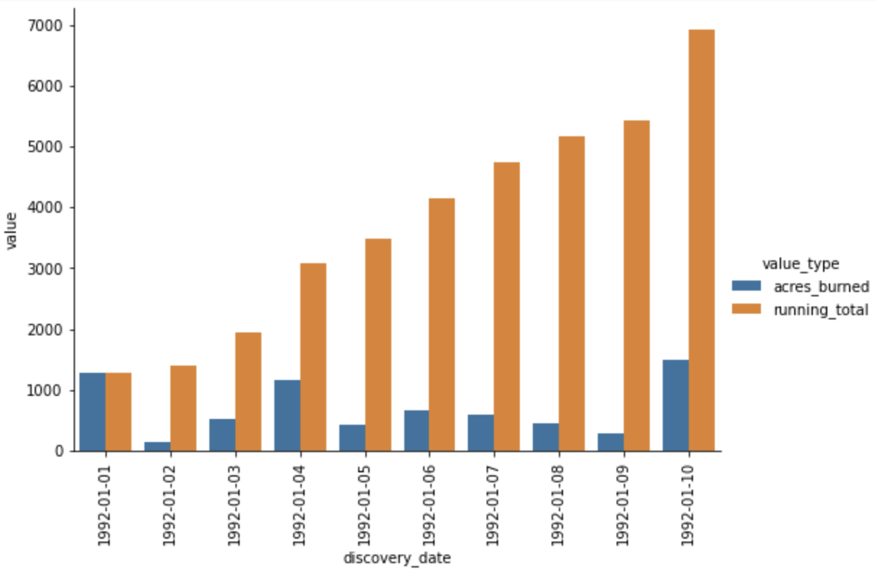
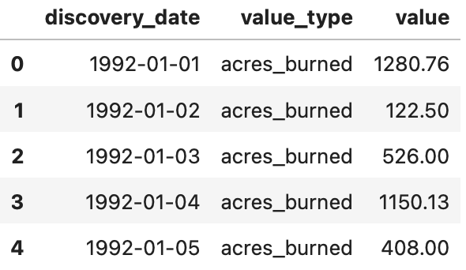
How to Plot Running Totals (Cont.)

Slide 48
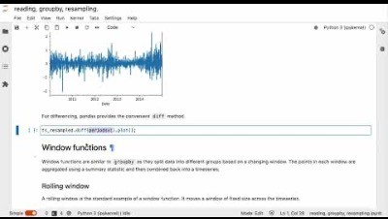
Movie Time ☺

Slide 49
References
Data science from scratch: first principles with Python, Joel Grus, O'Reilly Media, 2019
Python for Data Analysis: Data Wrangling with Pandas, NumPy, and IPython, Wes McKinney, O'Reilly Media, 3rd edition, 2022.
Python Data Science Handbook: Essential Tools for Working with Data, Jake Vanderplas, O'Reilly Media, 2022
Murach’s Python for Data Analysis, Scott McCoy, Mike Murach & Associates, Incorporated, 2021.
Intro to Python for Computer Science and Data Science: Learning to Program with AI, Big Data and The Cloud, Paul Deitel, Pearson Education Limited, 2021.
ChatGPT
https://www.health.gov.au/health-alerts/covid-19/case-numbers-and-statistics

Slide 50

End of lecture …
End of lecture …

